Slide 1
Topic Modeling

Slide 2
Why Topic Modeling?
A list of most frequent words is great, but often those words are “the”, “and”, etc.
Topic modeling uses term frequency–inverse document frequency (tf-idf) – a statistic that scores words on how important they are to document in a corpus
Topic modeling also uses Latent Dirichlet allocation (LDA) – a generative model of documents by which the computer identifies all the topics in each document in a corpus

Slide 3
Key Terms
Corpus – a group of separate documents one has brought together to analyze
Document – a distinct written piece
Word – strings separated by spaces inside a document
Topic – a collection of words that have a certain probability of occurring near each other in any part of a document
Determining the probability (significance) of one word occurring next to another throughout the document, instead of just measuring the significance of words to the whole document, is what gives topic modeling its “extra power”

Slide 4
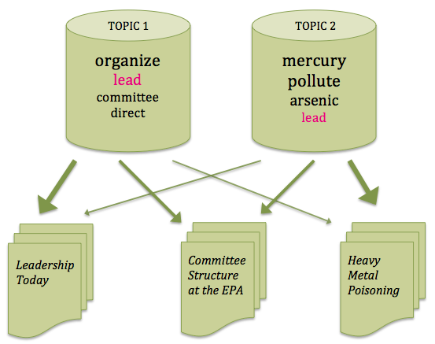
Topic Modeling in Action
Topic Modeling provides context of words in ways we haven’t see with word counts and frequency,
graphic appears in Ted Underwood’s Topic Modeling Made Just Simple Enough
Notes:
By putting words into topics – words that occur around each other with certain frequencies – the statistical model can start to determine some level of semantic meaning of words. In the example of above the model can ”understand” that “lead” appearing often around other words like “organize” and “committee” means lead the group and “lead” used occasionally with “mercury” and “pollute” means the metal based on how often the topic occurs throughout the document. The model can then predict the occurrence of these topics in any other document run through the model, and in the process the model becomes more sure of what words occur in each topic.

Slide 5
Topic Model Can’t Do Everything
The corpus one creates and how the corpus is cleaned will greatly limit the noise in the model and improve the topics generated
One has to decide how many topics to generate, which will also effect the quality of the topics (when someone says fine tuning the model when using topic modeling they often mean running models with different number of topics to figure out what number of topics return the most meaningful results)
Once the model creates the topics in the corpus, the topics need to be interpreted by humans

Slide 6
Tools for Topic Modeling
Voyant Tools – good for exploratory topic modeling but runs in browser so not optimize for large corpuses
David Mimno’s Topic Modeling Tool – again browser based so not meant for a large corpus. Provides more advance visuals than Voyant
Topic Modeling Tool – Same as Mallet but with a graphic users interface; best for those not comfortable with the command line
Mallet – for those comfortable with the command line

Slide 7
Other Advanced Text Analysis Methods
Natural Language Processing
Includes:
Sentiment analysis
Parts-of speech tagging
Named Entity Recognition
And others
Word Embedding – this type of text analysis begins to explore language on several levels of meaning and can be used to compare similarity between texts

Slide 8
Why Hasn’t Advanced Text Analysis Taken Over the Humanities
As Underwood’s blog shows, one has a lot to learn about corpus design, statistical modeling, and sometimes computer programming just to do topic modeling – not to mention other text analysis methods (not easy for many humanists)
In her article, Nan Z. Da brings up some valid points about why not text analysis in the Humanities:
Oftentimes humanities analysis is too nuanced and sparse for computer models that were made to do more straightforward tasks and on much larger datasets
What qualifies as Humanities research and does text analysis fit in? If so, does text analysis do the same or expand previous forms analysis?

Slide 9
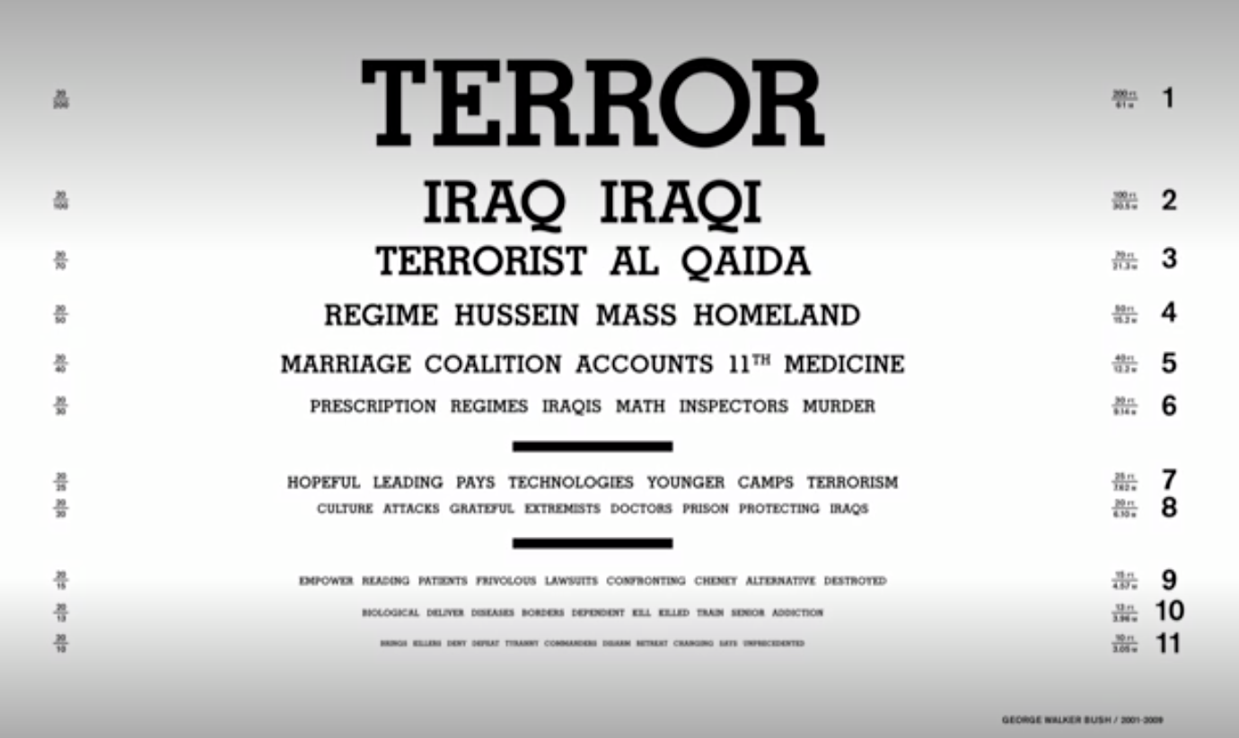
Let’s Explore
In his Ted Talk, R. Luke DuBois presents a kind of topic model of presidents’ State of the Union Address as eye chart art.
David Mimno’s in-browswer topic modeling tool is loaded with these same State of the Union addresses. Explore Mimno’s tool to see what you discover about the State of Union addresses through topic modeling. Does topic modeling have a place in the Humanities or should it be limited to the art like Dubois’?
The ”topic model” eye chart art for George Bush, Jr.’s State of the Union Address

